Slide 1
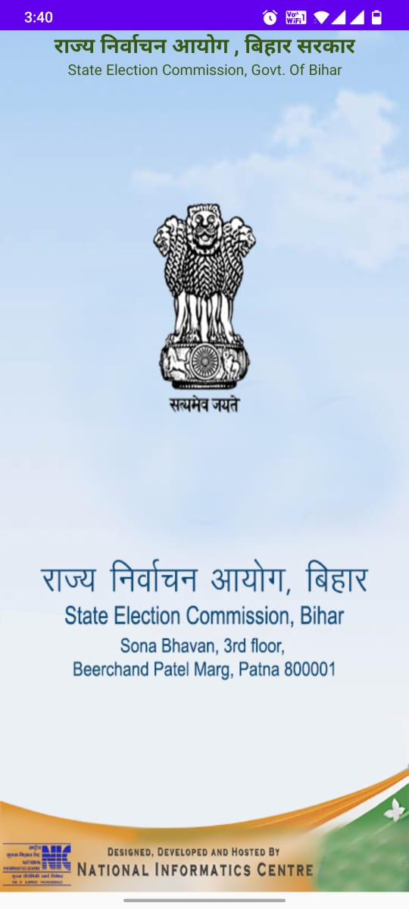
Ele-Booth App
Designed And Developed By NIC Bihar

Slide 2
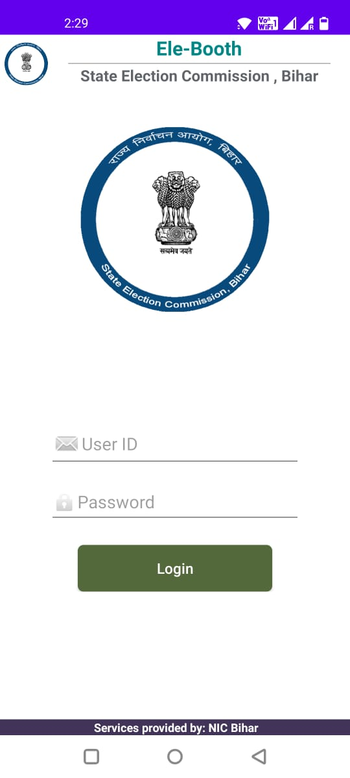
Ele-Booth App
Designed And Developed By NIC Bihar

Slide 3
About Ele-Booth App
This App is for Election Department , Bihar Government.
All polling station or booth can be located by this application “Booth Locator ” App.
Designed And Developed By NIC Bihar

Slide 4
Login
User Id
Password

Slide 5
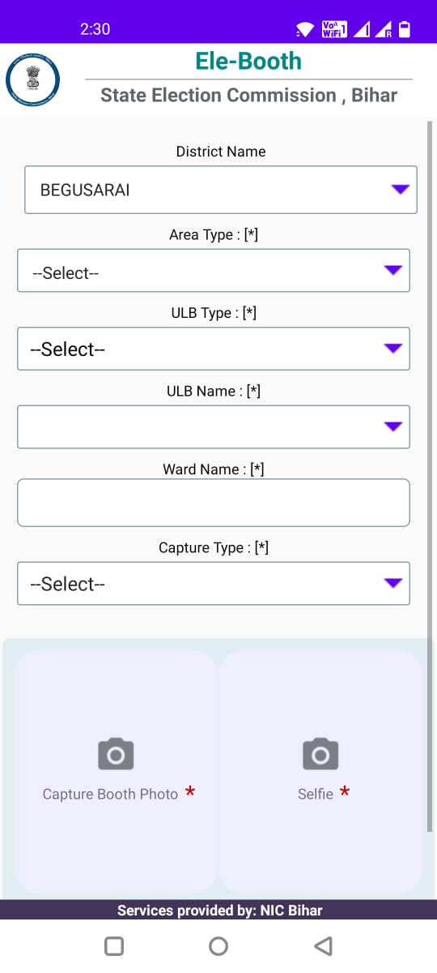
Entry Page

Slide 6
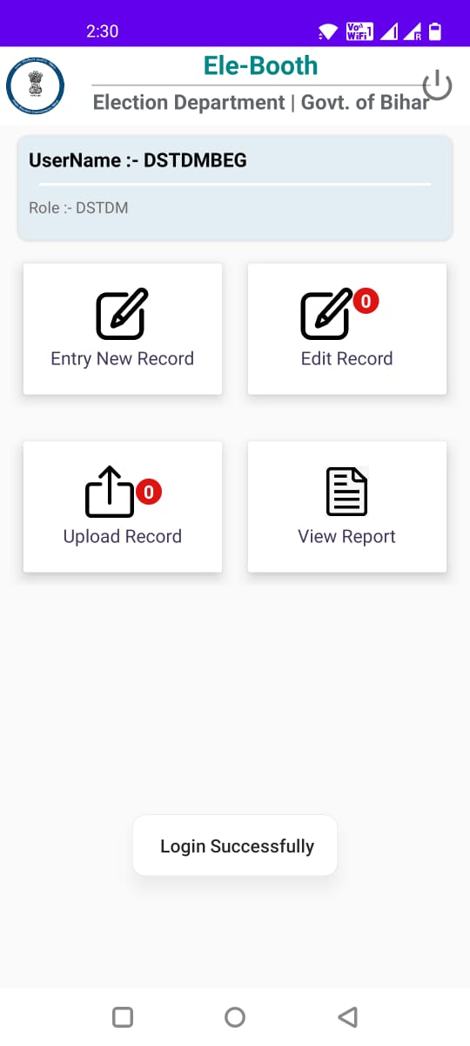
Saved Draft Records

Slide 7
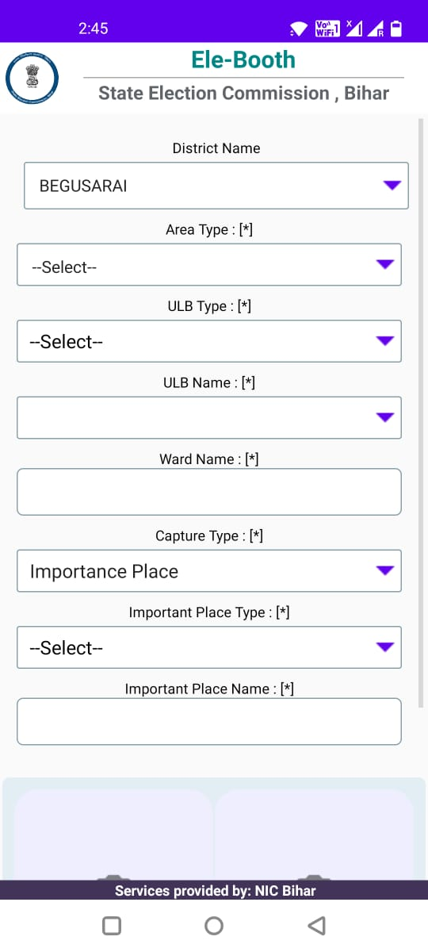
Saved Record’s Editable Screen

Slide 8
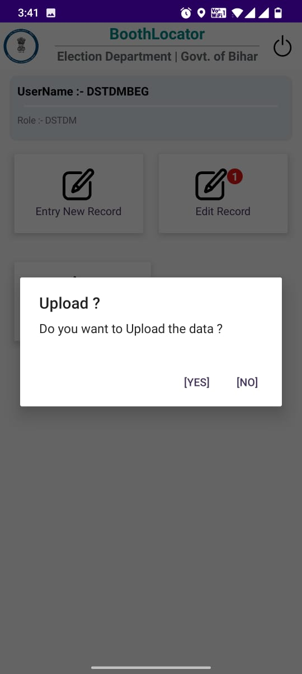
Upload to Server

Slide 9
Recorded Data

Slide 10
Thank you

